Slide 1
Structure diagrams
Structure diagrams represent the static aspects of the system.
It emphasizes the things that must be present in the system being modeled.
Since structure diagrams represent the structure, they are used extensively in documenting the software architecture of software systems.
@ShankaragoudaG

Slide 2
Class Diagram
Class diagrams are the main building block of any object-oriented solution. It shows the classes in a system, attributes, and operations of each class and the relationship between each class.
In most modeling tools, a class has three parts. Name at the top, attributes in the middle and operations or methods at the bottom.
In a large system with many related classes, classes are grouped together to create class diagrams. Different relationships between classes are shown by different types of arrows.

Slide 3
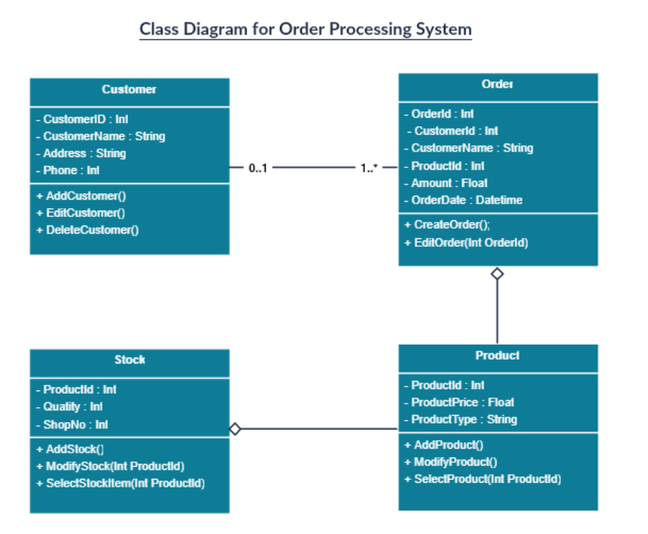
Class Diagram

Slide 4
Component Diagram
A component diagram displays the structural relationship of components of a software system.
These are mostly used when working with complex systems with many components.
Components communicate with each other using interfaces. The interfaces are linked using connectors.

Slide 5
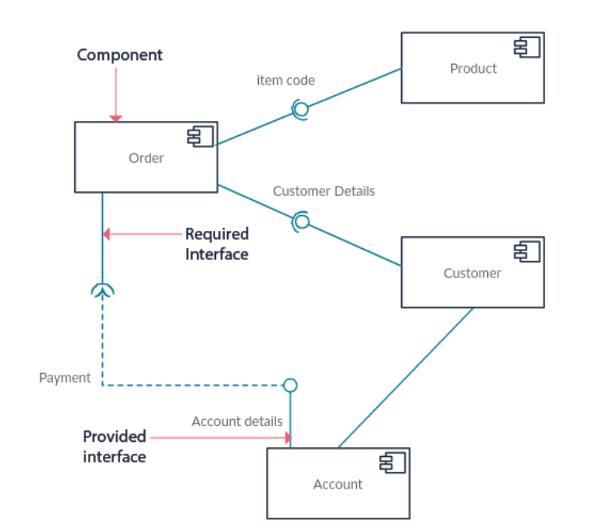
Component Diagram

Slide 6
Deployment Diagram
A deployment diagram shows the hardware of your system and the software in that hardware.
Deployment diagrams are useful when your software solution is deployed across multiple machines with each having a unique configuration.

Slide 7
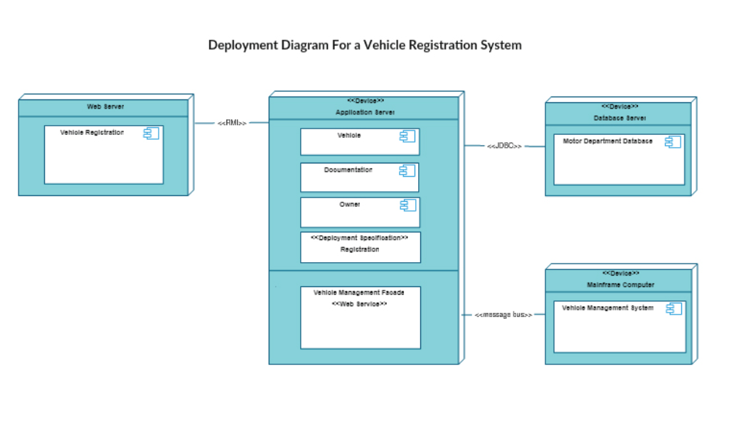
Deployment Diagram

Slide 8
Object Diagram
Object Diagrams, sometimes referred to as Instance diagrams are very similar to class diagrams.
Like class diagrams, they also show the relationship between objects but they use real-world examples.
They show how a system will look like at a given time. Because there is data available in the objects, they are used to explain complex relationships between objects.

Slide 9
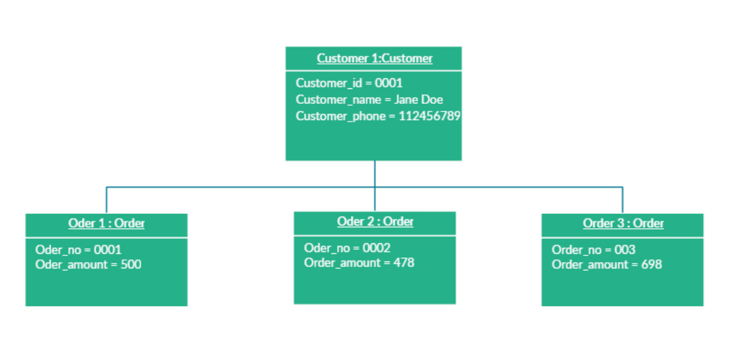
Object Diagram

Slide 10
Profile Diagram
Profile diagram is a new diagram type introduced in UML 2.
Profile diagram operates at the metamodel level to show stereotypes as classes with the «stereotype» stereotype, and profiles as packages with the «profile» stereotype.
The extension relation (solid line with closed, filled arrowhead) indicates what metamodel element a given stereotype is extending.

Slide 11
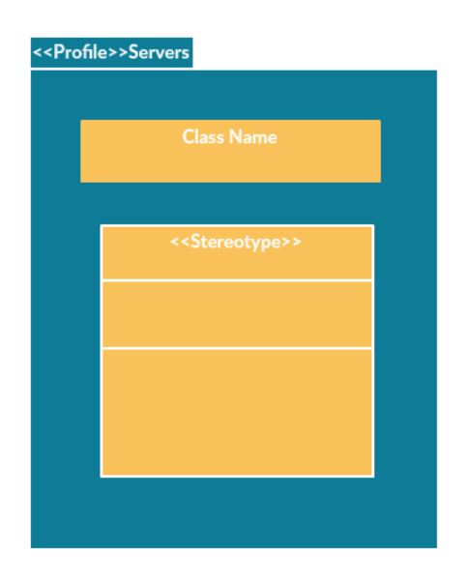
Profile Diagram

Slide 12
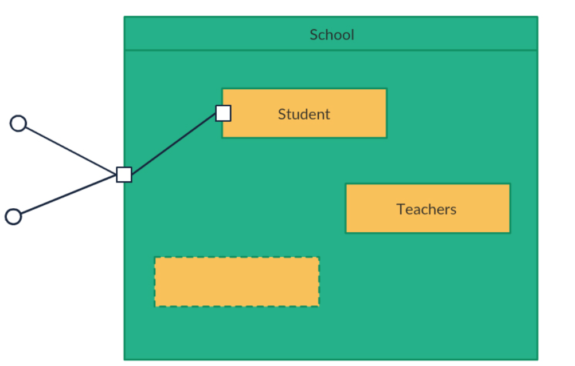
Composite Structure Diagram
Composite structure diagrams are used to show the internal structure of a class.

Slide 13
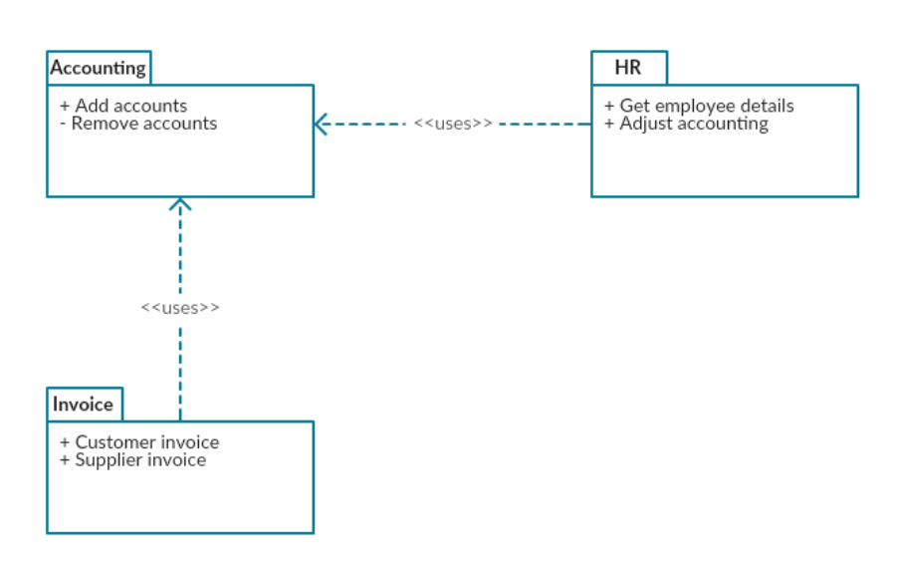
Package Diagram
As the name suggests, a package diagram shows the dependencies between different packages in a system.
A package diagram in the Unified Modeling Language depicts the dependencies between the packages that make up a model.

Slide 14
Useful Resources
https://en.wikipedia.org/wiki/Unified_Modeling_Language
https://creately.com/blog/diagrams/uml-diagram-types-examples/
https://www.javatpoint.com/uml-diagrams
https://www.tutorialspoint.com/uml/uml_standard_diagrams.htm

